Slide 1
UE20CS461A – Project Phase – 2
END SEMESTER ASSESSMENT
Project Title : Importance of Drug features in Drug-Drug Interaction
Project ID : 106
Project Guide : DR. PRAJWALA T R
Project Team :
PES2UG20CS173 | KUMARI SHIVANGI
PES2UG20CS194 | MEKALA SANJANA
PES2UG20CS217 | NAVEEN B N
PES2UG20CS504 | CHETANA N PATIL

Slide 2
Outline
Abstract
Summary of Requirements and Design ( Phase - 1)
Summary of Methodology / Approach (Phase - 1)
Design Description
Modules and Implementation Details
Test Plan and Strategy
Results and Discussion
Conclusion and Future Work
References

Slide 3
Abstract
A drug-drug interaction (DDI) describes a circumstance in which drugs affect the activity of each other.
Drugs may interact with each other to cause side effects that are unexpected or more severe than anticipated.
Drugs may also interact and oppose the results of one another, leading to one (or both) medications not having their intended effect. Most drug interactions are negligible, but some can be significantly harmful if not discovered and appropriately overseen.
Involves predicting the importance of drug features in drug-drug interaction
Features include - Solubility, Pka(acidic) , Pka(basic), LogP (ALOGPS) , LogP (ChemAxom)
Finding the essence of Structural embedding(SELFIES)in the interaction analysis.

Slide 4
Summary of Requirements and Design
1.GPU : Processing huge dataset requires the use of high processing systems.
2.Google Colab
3.Python
4.Deep Learning Libraries include Tensorflow , Keras
5.Tkinter

Slide 5
Summary of Methodology / Approach
Features
Random Forest
XgBoost
SVM
Drug 1
Comparative Analysis Models
Analysis and Selection of Model
Feature Importance Estimation
Drug 2
XGBoost+ Autoencoders
Capsule Network
CNN
Features

Slide 6
Summary of Methodology / Approach
The study involves comparative analysis including multiple models.
We take features of two drugs that are interacting, the features include permeability and solubility depiction
which include Pka(acidic) , Pka(basic), LogP (ALOGPS) , LogP (ChemAxom) and SMILES
Then substantially these features are dipped into models like SVM, Random Forest , XGBoost, Capsule Network
and CNN
Metrics of comparison are calculated which include accuracy scores, precision scores, F1 Scores, Recall ,
AUC values
By looking into metrics value we choose the best model for estimating feature importance and plot the
importance graph accordingly

Slide 7
Design Description
Algorithms Used:
Random Forest
XGBoost
SVM
Capsule Network
CNN
XGBoost + AutoEncoders

Slide 8
Modules and Implementation Details
# Preprocessing
1. Associate the interacting drug with target features and source features
2. Remove the data entries with null values
#Random Forest
3.Split the dataset for testing and training
4.Call the Random Forest Classifier Function for processing
5.Print results and feature importance metrics
#SVM
6.Call the SVC function on splitted data
7.Print results along with its metrics
#XGBoost
8.Call the XGB function on splitted data
7.Print results along with its metrics

Slide 9
Modules and Implementation Details
# Gradient Boost + AutoEncoders
8.Gradient Boost:
8.1.1. Define init class which initialises number of estimators(trees),learning rate also create an empty list to store trained decision trees.
8.1.2. Define fit method - Training takes place here. It iterates to the limit given in number of estimators.Calculate residuals(difference between actual and predicted Value) and fit the tree.Multiply the predicted value with the learning Rate and store it in the predefined list.
8.1.3 Define predict method- Iterate through stored trained trees, multiply each tree prediction by learning and sum these prediction by thresholding(0.5 here).
8.1.4 Run on the actual data and get results
AutoEncoders
8.1.5 .Encode the data to lower dimension for dimensionality reduction and effective feature learning and decoder tries to construct original data back from compressed data.
8.1.6. Extracted features are trained using Gradient Boost Classifier
8.1.7. Run on actual data by this combined model and display various metrics

Slide 10
Modules and Implementation Details
# 9.Capsule Networks:
9.1.1 Split the data - test and train —> 80:20 ratio
9.1.2 Input layer:Define number of neurons/Shape to input features in the dataset
9.1.3 Primary Capsule Layer:Create a Keras Conv1D layer with appropriate kernels and filter size.This layer aims to extract the essential features.
9.1.4 Digit Capsule Layer: Create a Squash Function - Take vectors from primary capsules and then identify spatial relationship amongst data features by normalising vectors.
9.1.5 Class Capsule Layer:Give the prediction result over here of the results in this layer
9.1.6 Compile and run the model

Slide 11
Modules and Implementation Details
# 10.CNN
10.1.1 Split the data - test and train —> 80:20 ratio
10.1.2.Input layer:Define number of neurons/Shape to input features in the dataset
10.1.3 Convolution Layer: Capture essential features by using Conv1D layer from Keras
10.1.4.Flattening Layer: Flattens/Convulges the output from Convolution Layer
10.1.5.Dense layer: Prediction
10.1.6.Compile and run model for 10 epochs
11. Manual Comparison on the results obtained while training and testing each model is noted and conclusion is made

Slide 12
Test Plan and Strategy
As we proceed with ML models it is evident to use 80 : 20 , where
80 % of Data for Training
20 % of Data for Testing

Slide 13
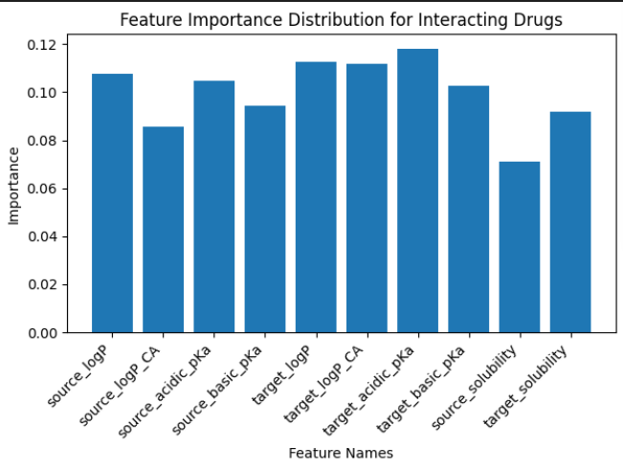
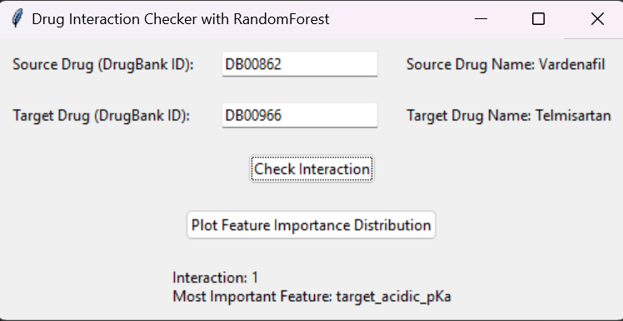
Test Plan and Strategy

Slide 14
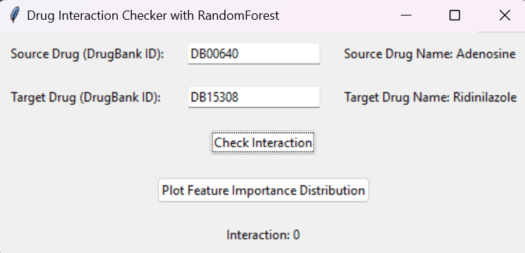
Test Plan and Strategy

Slide 15
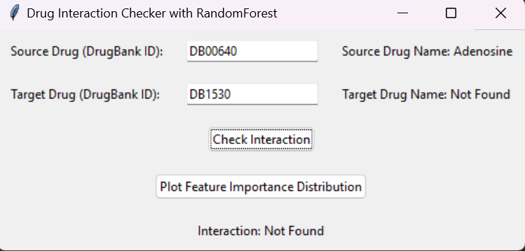

Test Plan and Strategy

Slide 16
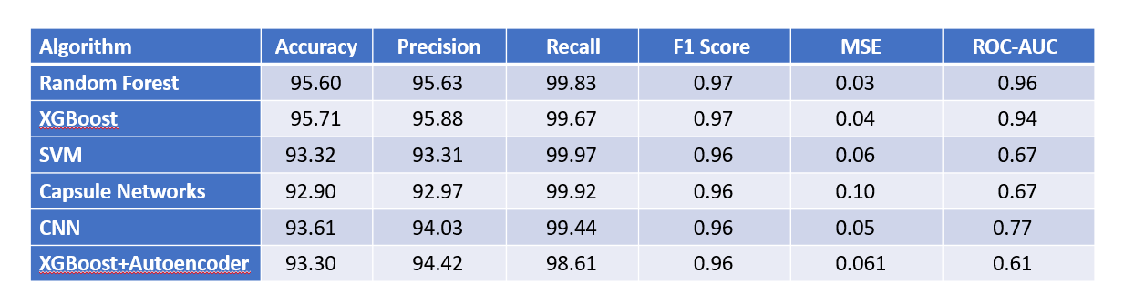
Results and Discussion

Slide 17
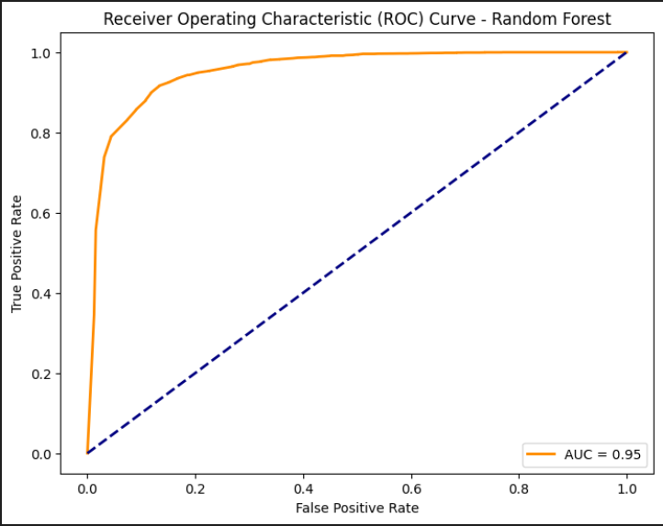
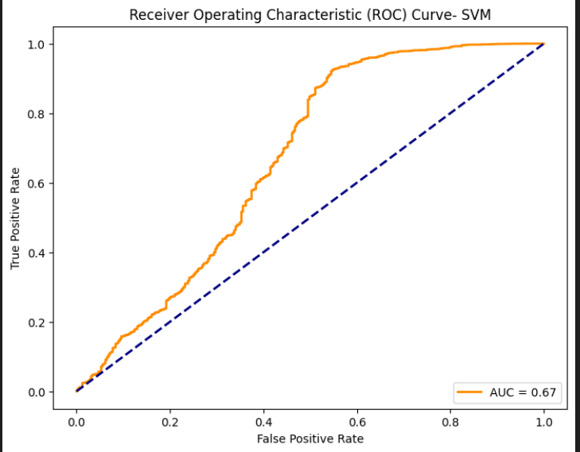
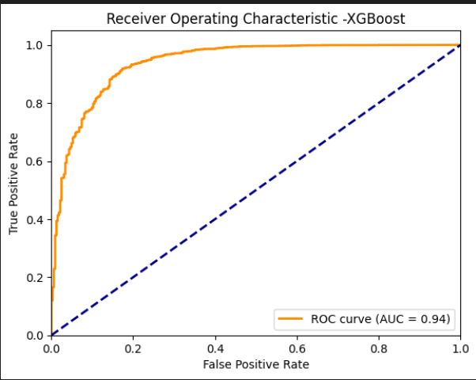
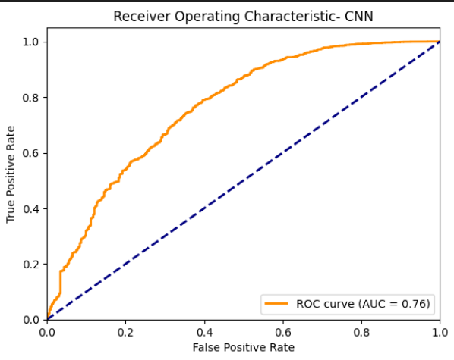
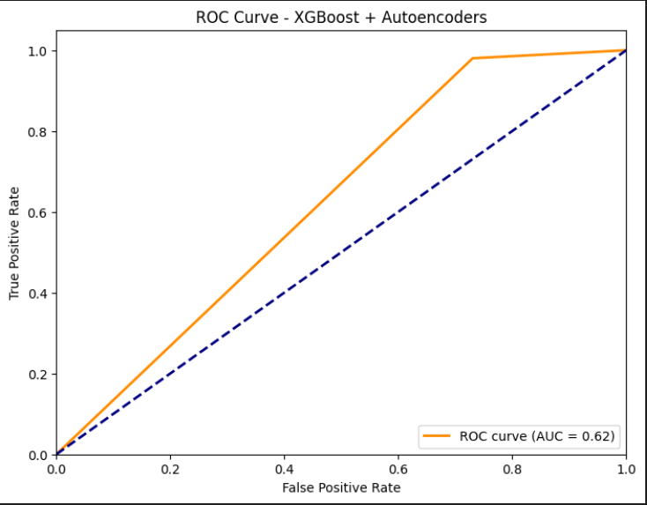
Results and Discussion

Slide 18
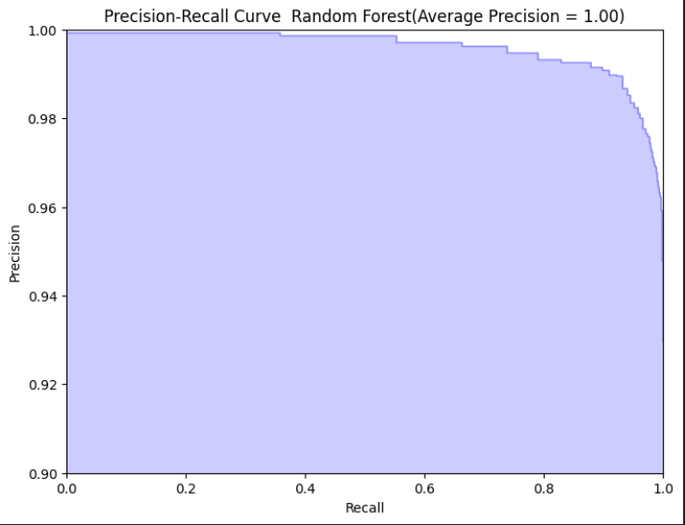
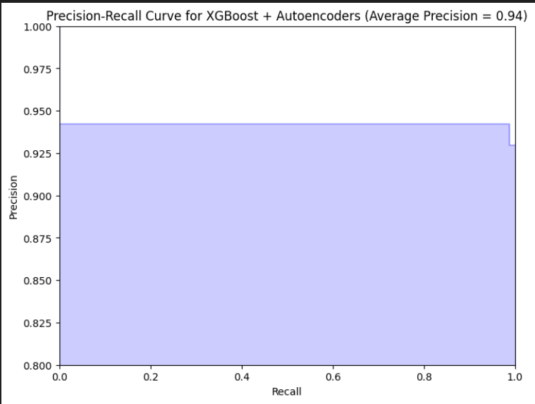
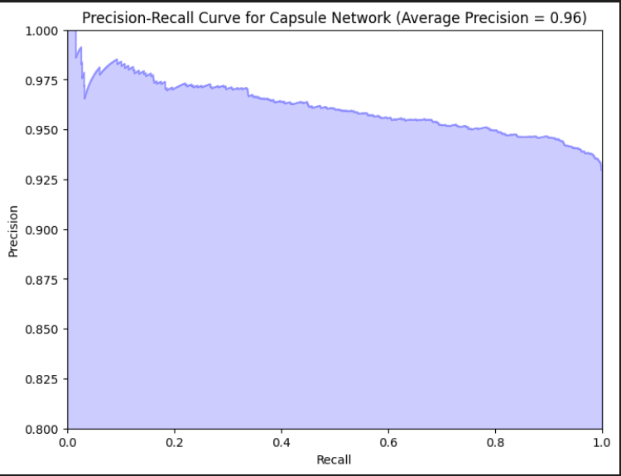
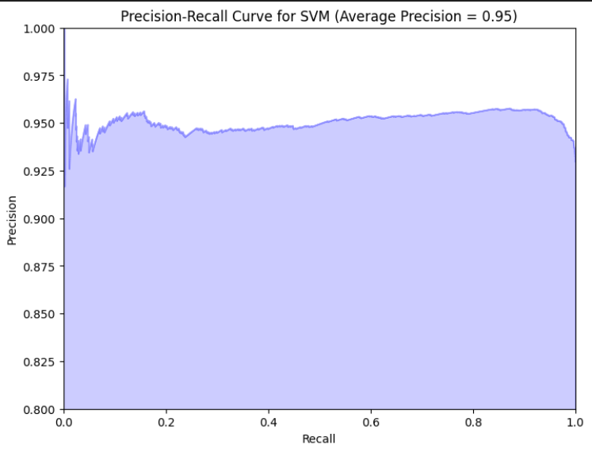
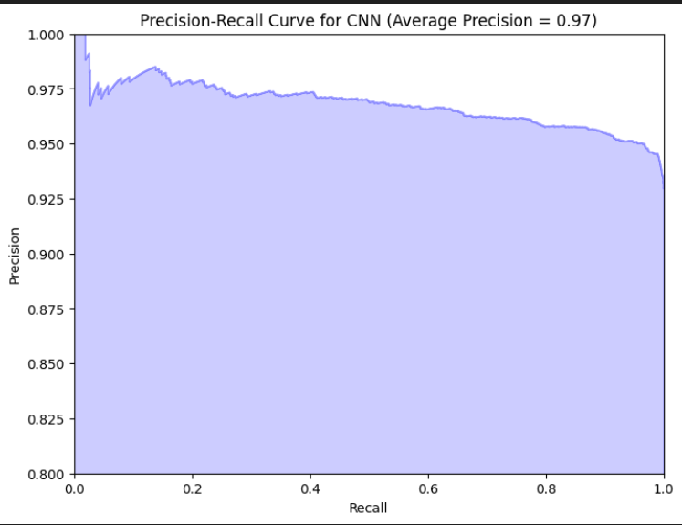
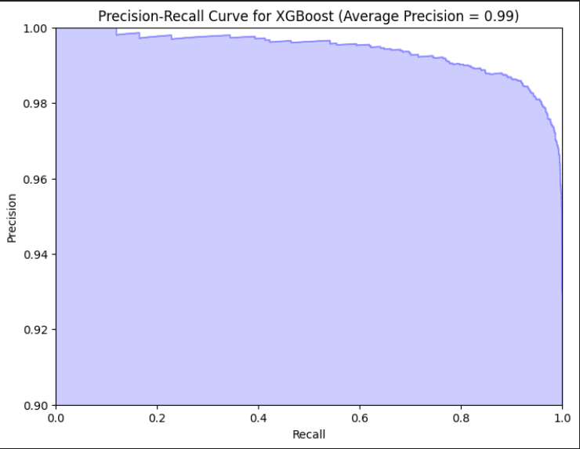
Results and Discussion

Slide 19
Conclusion and Future work
Overall XGBoost and Random Forest Classification Took a slight edge over other models in terms of performance and metrics
We have worked on only few features that could be involved in the drug-drug Interaction. Many other features also play a major role in the interaction
We plan to work on additional features that influence Drug – Drug Interaction

Slide 20
References
[1]Zhang,Qian Yu,Zongzhao Han,Xiaojing Du,”Enhancing drug–drug interaction prediction by three-way decision and knowledge graph embedding’,Springler Nature,2022
[2]E. Kim and H. Nam, “Deside-ddi: interpretable prediction of drugdrug interactions using drug-induced gene expressions,” Journal of cheminformatics, vol. 14, no. 1, pp. 1–12, 2022
[3] ChengCheng Zang, Yao Lu ,Tianyi Zang ,”CNN-DDI: a learning-based method for predicting drug–drug interactions using convolution neural networks”,BMC Bioinformatics,23,Article number :88(2022)
[4] Shaghayegh Sadeghi , Alioune Ngom, "DDI PRED:Graph Convolutional Network based Drug-Drug Interactions Prediction using Drug Chemical Structure Embedding" in IEEE, 2022.
[5] Nilay Fatma , Yıldız Alper Özcan, "Graph Convolutional Autoencoder and Generative Adversarial Network-Based Method for Predicting Drug-Target Interactions " published in 2022.
[6] Xu Gong, Maotao Liu, Haichao Sun,Min Li, Qun Liu, "HS-DTI: Drug-Target Interaction Prediction based on Hierarchical Networks and Multi-Order Sequence Effect" published in 2022.
[7] Tianjung , Wang , Xin , Liu, "A Graph Convolution-Transformer Neural Network for Drug-Target Interaction Prediction", ICBBT 2022, May 27–29, 2022.
[8] Chang Sun, Ping Xuan , Tiangang Zhang and Yilin Ye, "Using Supervised Machine Learning Algorithms for Drug-Target Interaction Prediction" in IEEE/ACM Transactions On Computational Biology And Bioinformatics, Vol. 19, No. 1, January/February 2022.
[9] Mohammad A. Rezaei , Yanjun Li , Dapeng Wu, Xiaolin Li and Chenglong Li,"Deep Learning in Drug Design : Protein-Ligand Binding Affinity Prediction" in IEEE/ACM Transactions on Computational Biology and Bioinformatics, Volume: 19, Issue: 1, 01 Jan.-Feb. 2022.
[10] Nelson R. C. Monteiro , Bernardete Ribeiro , and Joel P. Arrais,"Drug Target Interaction Prediction : end-to-end Deep Learning Approach" in IEEE/ACM Transactions on Computational Biology and Bioinformatics, Volume: 18, Issue: 6 , 01 Nov.-Dec. 2021.
[11] Liu S., An J., Zhao J., Zhao S., Lv, H. & Wang S, "Drug-Target Interaction Prediction based on Multisource Information Weighted Fusion" from Drug-Target Interaction Prediction Based on Multisource Information Weighted Fusion.Contrast media & molecular imaging, 6044256, 2021.
[12] Shichao Liu, Yang Zhang, Yuxin Cui, Yang Qiu, Yifan Deng, Wen Zhang, Zhongfei Zhang, “Enhancing Drug-Drug Interaction Prediction Using Deep Attention Neural Networks “, IEEE TRANSACTIONS ON COMPUTATIONAL BIOLOGY AND BIOINFORMATICS,2021
[13] Mongia A, Majumdar A,"Drug-Target Interaction Prediction using Multi Graph Regularized Nuclear Norm Minimization", from PLoS ONE 15(1): e0226484, 2020.
[14] Xinyu Hao , Jiaying You , PingZhao Hu, "Predicting Drug-Drug Interactions using Deep Neural Networks", ICMLC '19, February 22–24, 2019.

Slide 21
Thank You

